Slide 1


SALES PREDICTIONS USING MACHINE LEARNING ALGORITHMS
SALES PREDICTIONS USING MACHINE LEARNING ALGORITHMS
Presented by: Sayush Khadka
Year and Semester 2020-21 Autumn
Presented By: Sayush Khadka

Slide 2
AGENDA
1. Machine Learning
2. Topic and Problem Domain
3. Solving through machine learning
4. Algorithms used
5. Data cleaning and processing
6. Model fitting
7. Comparison of the models

Slide 3
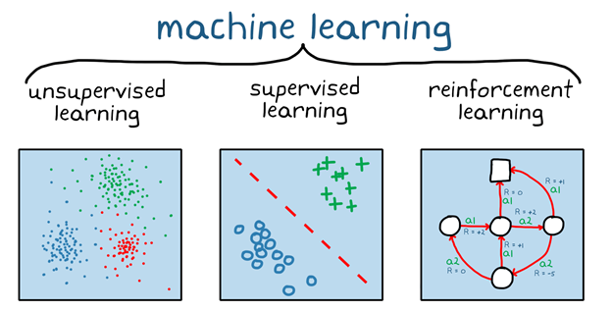

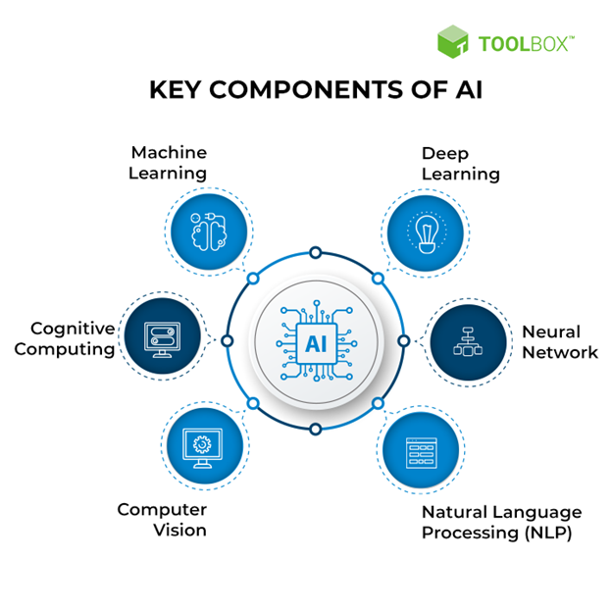
Machine Learning:
A component of artificial intelligence (AI) called machine learning (ML) enables software applications to improve their propensity to anticipate outcomes without having to explicitly train them to do so. By using historical data as input, machine learning algorithms forecast new output values.
In this area of artificial intelligence, algorithms and data are used to replicate human learning, enabling robots to become better over time, increase the accuracy of their classification and prediction systems, or explore new data-driven insights. It uses three methods to function: first, combining data and algorithms to find patterns and classify data sets; second, assessing accuracy using an error function; and third, optimizing the fit of the data points into the model

Slide 4
Topic and Problem Domain
A sales forecast is used to estimate future sales revenue. The health of the sales pipeline, market trends, and prior performance are frequently considered in sales estimates. A tool used by firms to forecast weekly, monthly, quarterly, and annual sales totals is the sales forecast.
Importance:
The future is considered in forecasts.
Privately held businesses have more faith in their operations when leaders can put their trust in forecasts.
Accurate predictions enhance the market credibility of publicly traded corporations .
The entire organization gains from forecasting sales.
Sales estimates are used by production to plan its cycles, and by finance to develop budgets for hiring and capacity planning.
Forecasts aid in the planning of territory and targets for sales operations, channel and partner plans for sales strategy, and manufacturing capacity planning for the supply chain.
Problems with manual forecasting:
Time-consuming
Biased and inaccurate
Error-prone Human Mind
Limited data for forecasting
How can Machine Learning be used to Predict Sales?
Machine learning examines millions of data points using several approaches, such as clustering and regression, before making predictions. Data points include things like demographic information, behavioural trends, and previous transactions. Businesses utilize machine learning algorithms to predict sales and revenue. This is done by using data from previous transactions to predict consumer behaviour. Businesses may create accurate estimates and prepare for impending occurrences by doing this.

Slide 5
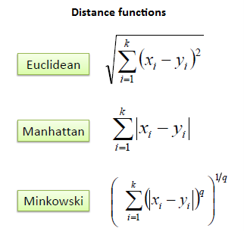
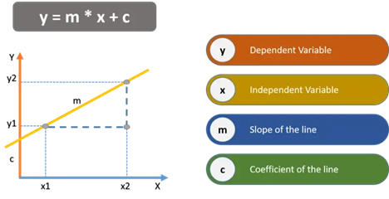
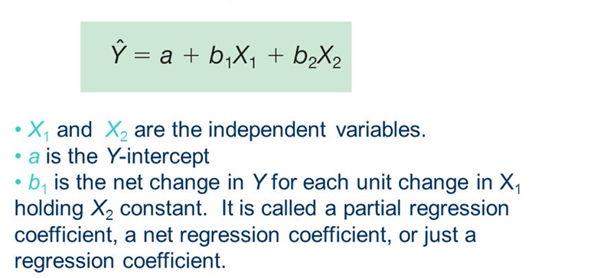
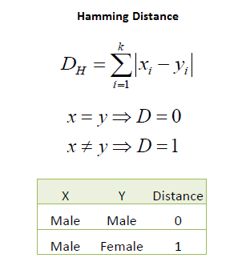
Algorithms used:
Linear Regression:
KNN (K-Nearest Neighbor Regressor):
Simple Linear Regression
KNN –
continuous variables
Multiple Linear Regression:
KNN-
categorical variables

Slide 6
Data cleaning and pre-processing:
Handling missing values
Further cleaning some categorical column
Removing outliers
Visualizing the dataset
Removing unwanted columns
Encoding
Input and Output Feature Split
Feature Scaling

Slide 7
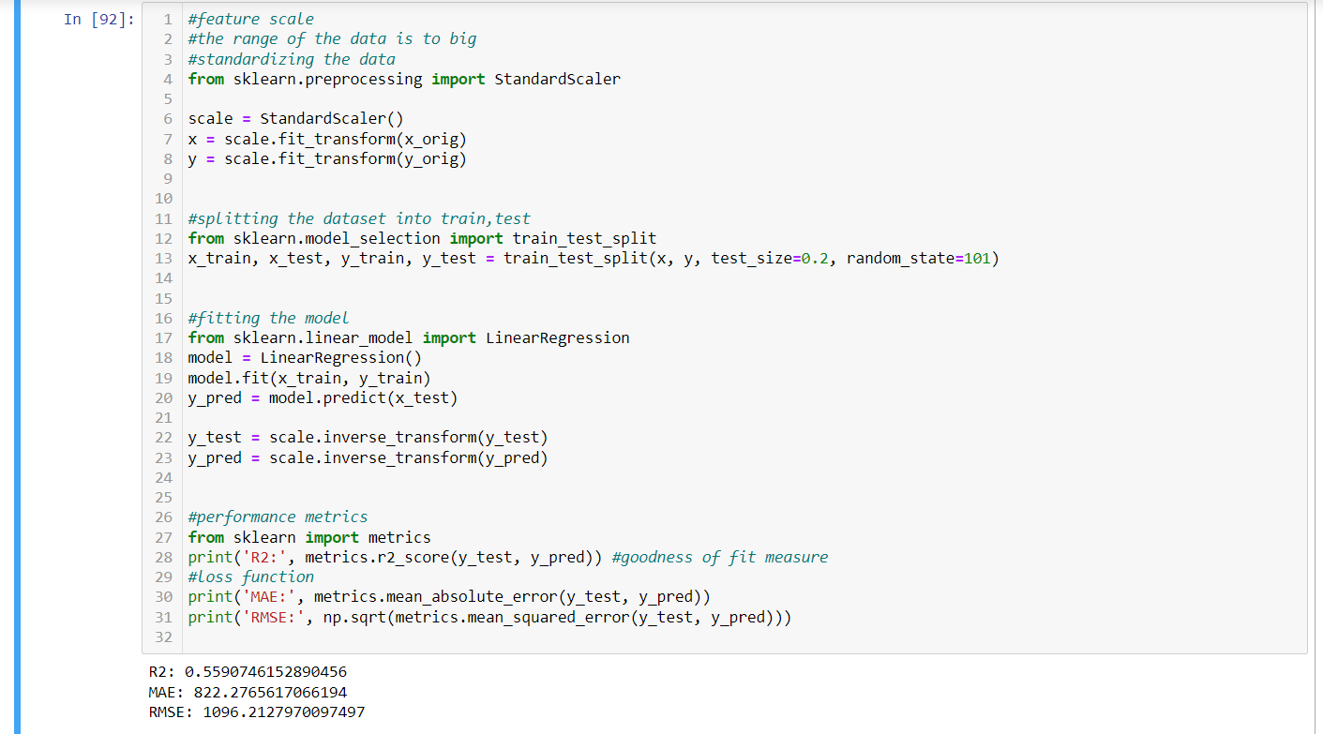
Linear Regression (Model Fit):

Slide 8
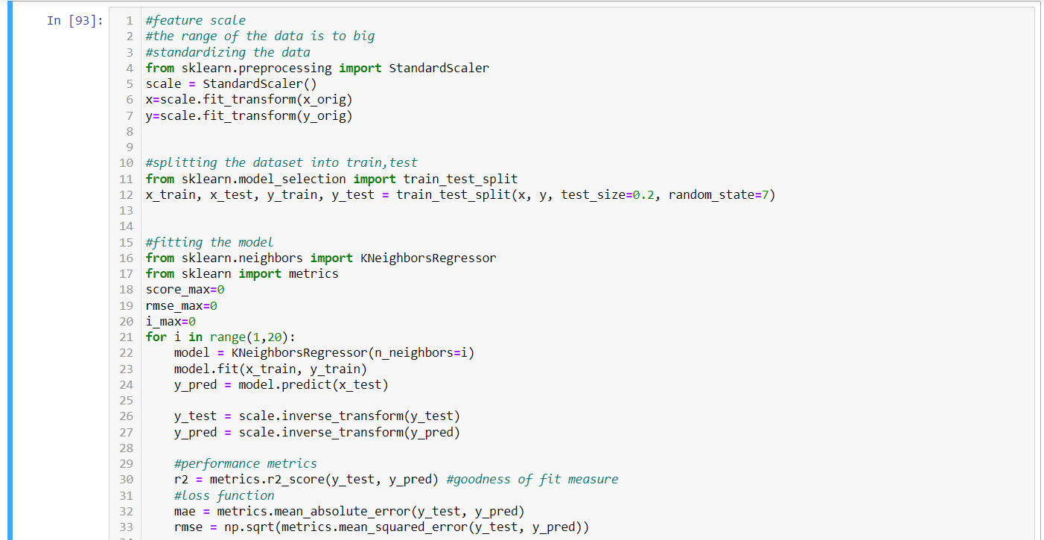
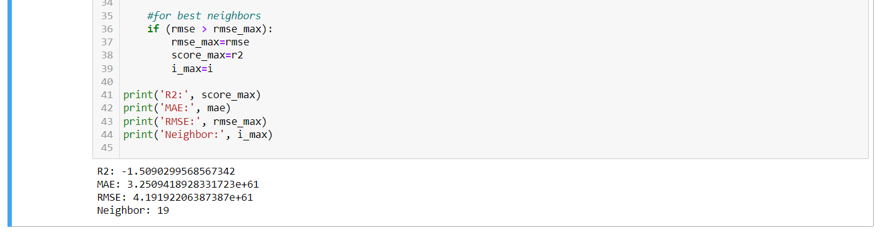
KNN (K-Nearest Neighbor Regressor) (Model Fit)

Slide 9
Comparison Table
Algorithms | R-Squared (R2) | Mean Absolute Error (MAE) | Root Mean Square Error (RMSE)
Linear Regression | 0.5590746152890456 | 822.2765617066194 | 1096.2127970097497
KNN (K-Nearest Neighbor Regressor) | -1.5090299568567342 | 3.2509418928331723e+61 | 4.19192206387387e+61

Slide 10
Model comparison and conclusion:
Comparing the R-squared (R2) score itself:
Interpretation of R-squared (R2) score
If the R2 score is 0 then the mean line and the regression line is making the same error value which means, the mean line and the regression line are the same.
If the R2 score is 1 then the regression line is not making any error which means the perfect state. (This is not possible)
From the above statement,
The more the model performance moves toward perfection the more the R2 score moves toward 1.
The more the model performance moves away from perfection the more the R2 score moves toward 0.
For negative R2 score,
The regression line is making more errors than the mean line meaning the performance is the least as it can be.
Conclusion of the comparison:
The R2 score of Linear Regression is 0.5590746152890456 which is nearer to 1.
The R2 score of KNN (K-Nearest Neighbor Regressor) is -1.5090299568567342 which is a negative R2 score.
For the other 2 performance metrics (Mean Absolute Error (MAE), Root Mean Square Error (RMSE)) Linear Regression has better performance scores by far as KNN (K-Nearest Neighbor Regressor) as its performance scores in exponential notation.
Conclusion:
Therefore, Linear Regression is suitable among 2 models (Linear Regression and KNN (K-Nearest Neighbor Regressor)) for this dataset.

